Slide 1
How Aligning with Disability can Help Improve Medical Care & Re-Imagine the Possibilities for Intersex Flourishing
By: Gustavo Serafini

Slide 2
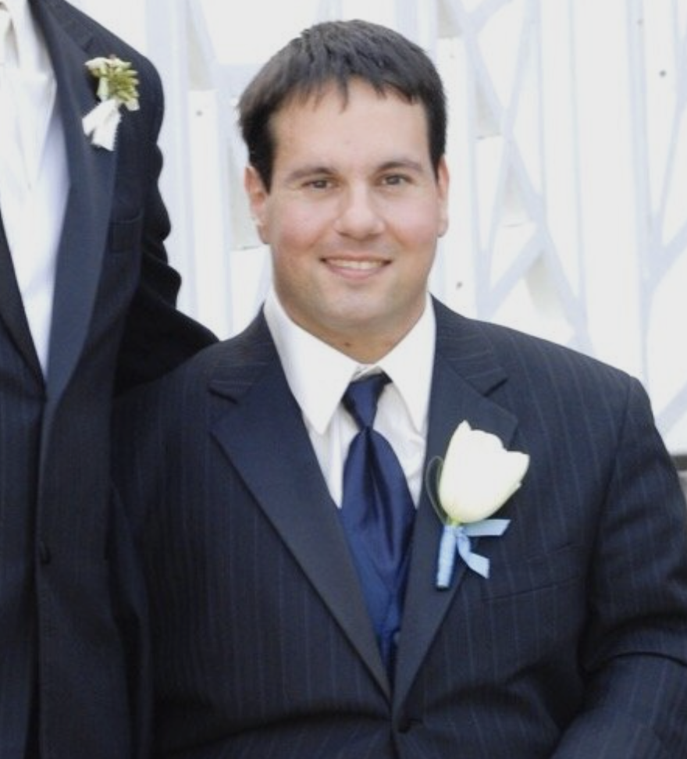
My Background
Born with multiple disabilities and intersex
Entrepreneur
Podcaster, Enabled Disabled
UD (Universal Design Activist)
New advocate for the intersex community

Slide 3

Presentation Goals
Explore the Differences Between Pathologized Care vs PCR
What I experienced as a child compared to mid-life
Explore the Recent Trend in Rehab Medicine: PCR (person centered rehab)
I experienced this as a patient with Shirley Ryan Ability Lab.
Question the Foundations of Modern Medicine: Who Defines us? Who do we Let Decide Our Worth?
Linking the Importance of Personhood with Better Care & Human Flourishing
How we understand ourselves matters to how we are treated & exist in the world
Overarching Theme: Interconnectedness Between Intersex and Disability
Celeste Orr, "Cripping Intersex" and Sara Hendren, "What can a Body Do?"

Slide 4
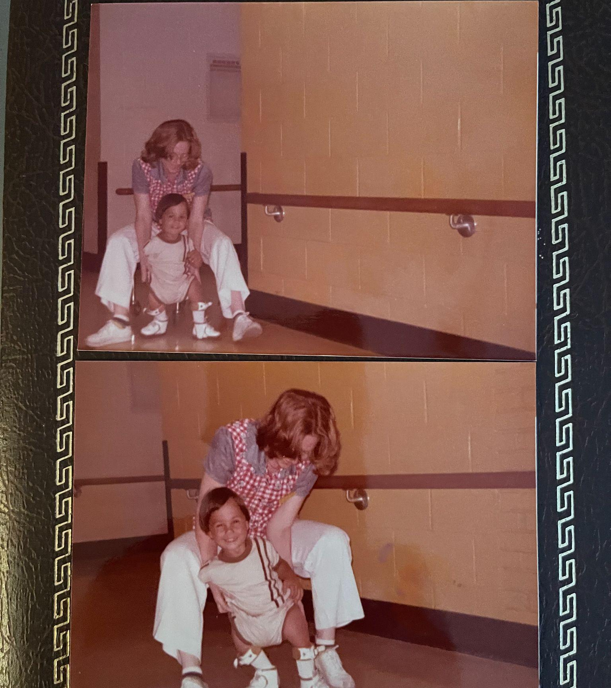
What is PFFD?
Rare congenital condition (12 documented cases of bilateral PFFD when I was born in 1976)
Features shortened femur and multiple variations of hip differences (unstable or limited hip mobility)

Slide 5
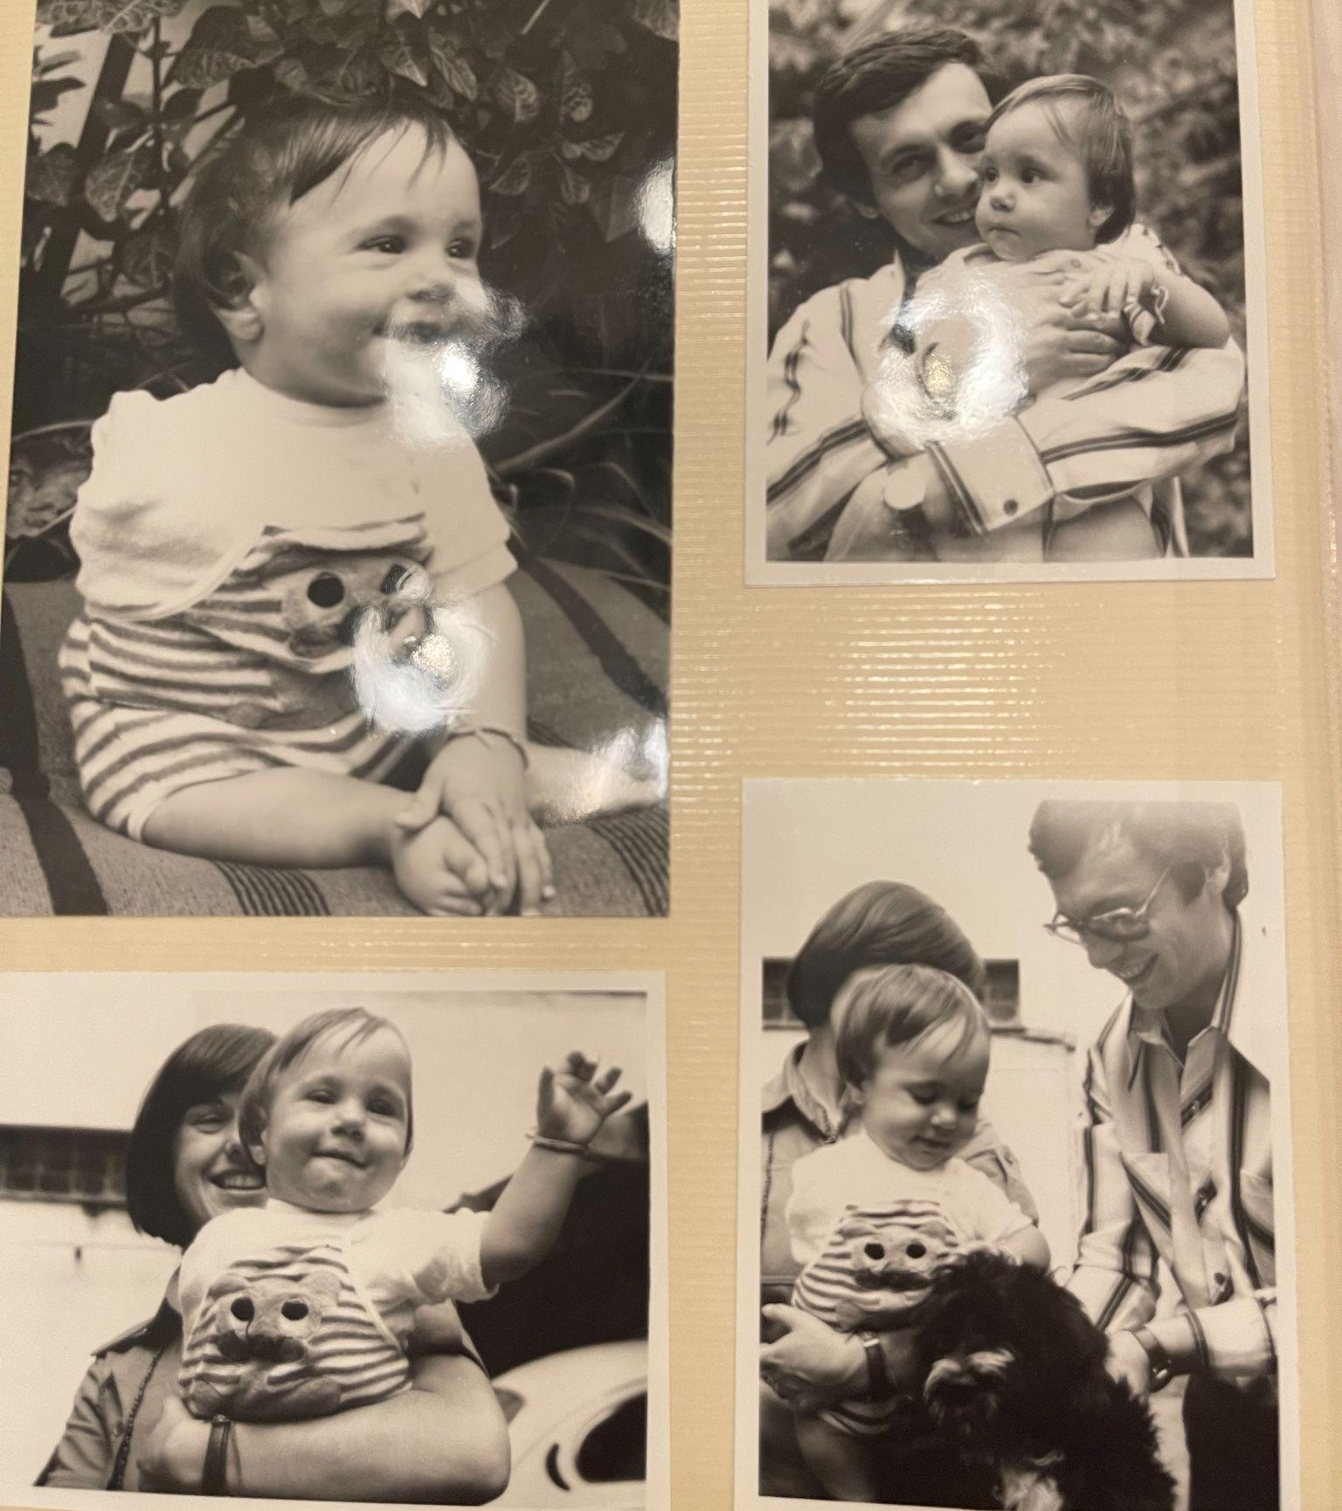
How I was Pathologized by Doctors
One doctor told my parents (when I was 1) that I would never walk, but be relegated to crawling like a snake for the rest of my life
More open-minded doctors looked at me as fundamentally defective and needing serious medical care for the rest of my life

Slide 6
The Surgeon and Van Ness Procedure
At 12 years old, a famous surgeon approached us with a "fix"
The Van Ness procedure, still used today, rotates your ankle 180 degrees to act like a knee and lengthens your limb with a prosthetic.
There were major risks of de-rotation and multiple surgeries
We all decided together to not do the surgery; it was too new and too risky
The Surgeon's Wrath
The surgeon was offended and told my parents they were dooming me to be short all my life and have limited mobility. Parents were robbing me of a better future

Slide 7
Long Term Effects of Medical Pathology
Defective as born. Life was about overcoming (i.e. working harder, being smarter) just to have a chance at living a decent life. Shame based: difference is inherently negative.
Parental Guilt: did we make the right decision? Is Gustavo going to blame us later for not doing the surgery? It is a quandary, and one that stays with you. A haunting: "one way in which abusive systems of power make themselves known and their impacts felt … especially when they are supposedly over and done with." - Orr, page 25-26

Slide 8
Non-Pathologized Care: the Shirley Ryan Approach & PCR
Founded in 1954 as the Rehab Institute of Chicago
Communal in nature: doctors, nurses, therapists, and patients ate together, and formed connections that extended beyond treatment
Dr. George Betts (& others) saw Disability Differently
"Children born with disabilities are fundamentally whole and complete just as they are. It is everyone else in society who tells them something is wrong with them"
In 2017 they became the Shirley Ryan Ability Lab
Focused on translational (i.e. "bench to bedside") medicine and personalized care. There are NO surgeons on staff

Slide 9
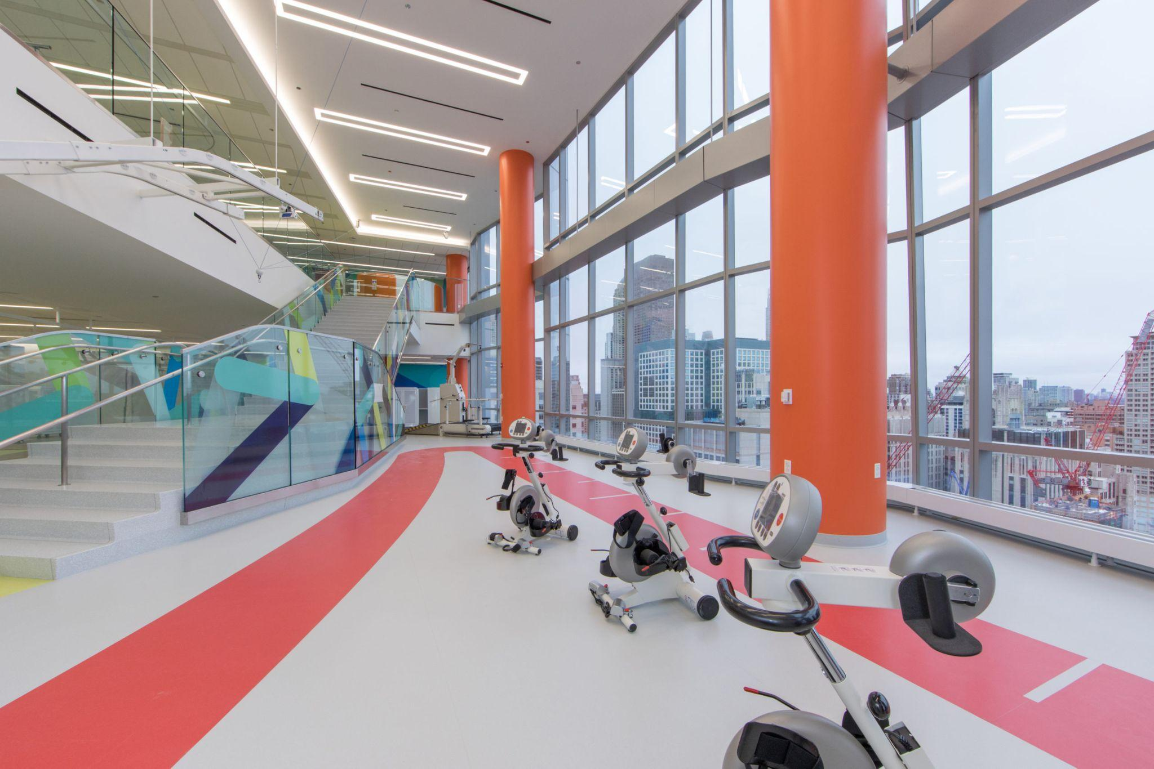
Shirley Ryan Ability Lab
Leading Research Facility
Translational Medicine
PCR Imbued in their culture
Image Copyright - Shirley Ryan Ability Lab

Slide 10
Person Centered Care (or Rehab)
"PCR refers to a culture of service focused on the needs of the whole person, not merely those arising from patients as objects of biomedical conditions and interventions. PCR is respectful of and tailored to the unique characteristics and circumstances of the person (perspectives, preferences, values,experiences, worldview) beyond consisting of individualized interventions addressing the impairments or symptoms of unique patients."
"PCR nurtures notions of personhood, the person’s self-determination, and values the singularities (ie, unique characteristics) of each person. Persons should be treated with respect, dignity, and valued as persons with needs, resources, and capabilities. Each person has an equal right to experiencing a PCR approach. PCR is accepting, nonjudgmental, embraces individual differences, and aspires to reduce any power differentials exerted by professionals in the person-professionals dyad."
- Jesus, T. S., et al. (2021). "Scoping review of the person-centered literature in adult physical rehabilitation." Disability and Rehabilitation: An International, Multidisciplinary Journal 43(11): 1626-1636.

Slide 11
Person Centered Care (or Rehab) cont.
"Because situations and persons’ characteristics vary, PCR cannot be fully guided, standardized, or dictated. Rather than merely being protocol-driven or a '1-size-fits-all' approach, it is antireductionist and adaptive to situations at hand. ... Altogether, PCR is complex, subject to failure, and involves continuous learning and adaptation. It requires humility, mindful questioning, ethical reasoning, and critical reflection in and on one’s actions ..." - Jesus, T. S., et al. (2021). "Scoping review of the person-centered literature in adult physical rehabilitation." Disability and Rehabilitation: An International, Multidisciplinary Journal 43(11):1626-1636.
"Within healthcare more generally, person-centered care has been structured as a counter to a reductionist biomedical focus on disease or trauma, or to the systems, budgets, or staff focus that many hospitals and other healthcare providers appear to operate under. When assessing wellbeing and satisfaction, there is little question that person-centered care improves the experience of patients, with increasing evidence that relationally orientated care is central to any number of positive outcomes."
- Gareth Terry & Nicola Kayes (2020) Person centered care in neurorehabilitation: a secondary analysis, Disability and Rehabilitation, 42:16, 2334-2343, DOI:10.1080/09638288.2018.1561952

Slide 12
PCR Evolved: "Ultrabilitation"
"This special issue questions if and how recovery principles embedded in rehabilitation support human flourishing through an exploration of 'ultrabilitation.' Ultrabilitation is a concept developed by Buetow, Martinez-Martin and MCormack that rejects the normalizing tendencies of rehabilitation, and particularly its embedded notions of recovery towards a previous state. In proposing this new conceptualization, the authors ask health providers to 'question and debate the continuing sufficiency of rehabilitation as optimal care.' Moreover, they suggest that rehabilitation might be better oriented to 'human flourishing', that is, a life of 'meaning and purpose' in 'developing and using one’s capabilities' … "
Gibson, B. E., et al. (2020). "The micro-politics of caring: Tinkering with person-centered rehabilitation." Disability and Rehabilitation: An International, Multidisciplinary Journal 42(11): 1529-1538.

Slide 13
Pockets of Care: where is PCR currently applied?
Rehab Centers (includes physiatry, occupational therapy, physical therapy, neurorehabilitation)
Palliative Care
Nursing Homes and Assisted Living Facilities

Slide 14
How we Became Pathologized: the Concept of the Average
Key Framework: Todd Rose's "The End of Average"
co-founder of Populace, former director of Harvard's Lab for the Science of Individuality and Director of the Mind, Brain, & Education Program
Main Argument: the average for humans is based on pseudoscience
Multiple Studies across many disciplines have shown this to be true
Better Approach: first understand the individual, then find patterns
Humans are better understood as jagged, context dependent, and develop in multiple pathways, all of which are natural We will go over the first and last principles

Slide 15
A Brief History of how "the Average" found its way to Humans
Quetelet (1796): mathematician and astronomer. When 1st career failed, he asked, "might it be possible to develop a science for managing society?" Declared that "the individual person was synonymous with error, while the average person represented the true human being." Result, everything that varied from the "average man's proportions" was considered "deformity and disease." The "average" became "normal, the individual error, and stereotypes validated with the "imprint of science."
Galton: mathematician and student of Q. Believed it was "the imperative of humankind" to improve on the average, so he redefined error as "rank." To help him prove this, he developed new statistical methods, including correlation, allowing him to "assess the relationship of rank across different qualities." Further belief: if you were high ranking in one trait, you were high ranking in all others.

Slide 16
Study #1&2: US Air Force & Brain Wave Study– There is No Average Body or Brain
In the 1940's planes were crashing at an alarming rate. They studied over 4,000 pilots, over 140 body dimensions. Results: Not a single airman fit within the average range when only 10 bodily dimensions were used. When 3 bodily dimensions were compared, only 3.5% were 'average'!
Brain Wave Study (Neuroscientist Michael Miller): create a map of the "average brain" showing the neural circuits involved in verbal memory. Results: all brains were different from everyone else's. Nobody's brain looked anything like the average. "What was most surprising was that these differences in patterns were not subtle, they were extensive." - page 22 Redaction Bias: no left-handed people included!

Slide 17
Study #3: Human Development is not a Ladder, it is a Unique Web (Pathways Principle)
For almost 60 years scientists believed that there was a "normal," predetermined pathway a human child developed, from crawling, to standing, to walking.
Dr. Karen Adolph (developmental psychologist) tracked the development of crawling to walking. Result: out of 28 children, there were no less than 25 different pathways, each with its own unique movement pattern. "Our biology does not compel us to follow a predetermined blueprint. … Every baby solves the problem of movement in her own unique way." - page 127

Slide 18
Study #3: Human Development is not a Ladder, it is a Web (cont.)
"Eventually, the discrepancies between human development and those supposed normal pathways became so obvious that it created what came to be known as 'the crisis of variability' in developmental science." - page 136
There is not a single, normal pathway for ANY type of human development (biological, moral, mental, professional, etc.). See Bloom study, Khan Academy.
Psychologist Kurt Fischer: "each one of us has our own web of development, where each new step we take opens up a whole new range of possibilities that unfold according to our own individuality."

Slide 19
Hidden Biases of Within the "Average":
Not only people at the margins are being harmed by the "Average": nearly every human is being harmed! All humans are a biological N of 1!
The variety of human life is not embraced; instead, it is something to be feared, contained, and controlled.
Claude Bernard (father of experimental medicine): "physicians have nothing to do with what is called the law of large numbers, a law which, according to a great mathematician's expression, is always true in general and false in particular"

Slide 20
Cripping Intersex: Normalizing Disability and Intersex
Key Framework #1: Celeste Orr, "Cripping Intersex"
"At this juncture, undermining dyadism is impossible without also undermining compulsory able-bodiedness. Rather than distance from disability, intersex studies and activism ought to embrace and celebrate the necessary theoretical and methodological tools offered by feminist disability and crip studies." - Page 63
Key Framework #2: Sara Hendren, "What can a Body Do?"
Exploration of the evolution of Deaf Space; how a community re-defined themselves and embraced their differences in uniquely positive and fundamental ways.
Weaving the Threads: Disability and Intersex
We are beautiful as born, unique individuals who have the right to flourish

Slide 21

Shared Spaces: Compulsory Dyadism and Able -Bodiedness
Both groups deviate too far from "average" or "normal" bodies
Medically pathologized in similar ways: surgeries, sterilization, shame
Normative Thinking is designed to Poison our Sense of Self & Limit our Potential

Slide 22
A Guide for Fundamentally Re/imagining Ourselves? An Exploration of Deaf Culture
A brief history: the National Institution for Deaf-Mutes was established in France in 1776, and was widely influential internationally. 19th Century Nationalist campaigns sought to homogenize speech and language: "a reactionary and ultimately eugenic push for 'oralism' swept through modernizing Western cultures … Signing, as a minority language, was discouraged as a threat to the unifying work of national culture." - SH, 106
Milan Conference of 1880: "an international confederation of teachers for the deaf, agreed as a group on the 'incontestable superiority of speech over signs.'" -SH 106 It set them back 90 years!

Slide 23
An Exploration of Deaf Culture (cont.)
Deaf culture became recognized as culture and political identity in the US in the 1970's. Gallaudet University was influential. Activists "made a strong case for their language (ASL), their history, and their culture as a fully normal variation on human existence; some took on Deaf as an identity, capitalizing it as a proper name on par with ethnicity." -SH, 106
Gallaudet University remade it's campus in the mid 2000s (Deaf Space) incorporating more than a 100 design elements in collaboration with students, faculty, researchers, and architects: "We're spherical people … so it makes sense that the architecture here should beautifully bear out deafness as a way of being. Signing is 3-dimensional by nature, so it implies not just words in a line, but heights and widths and depths for making language the rich repository of communication that it is." - SH, 103

Slide 24
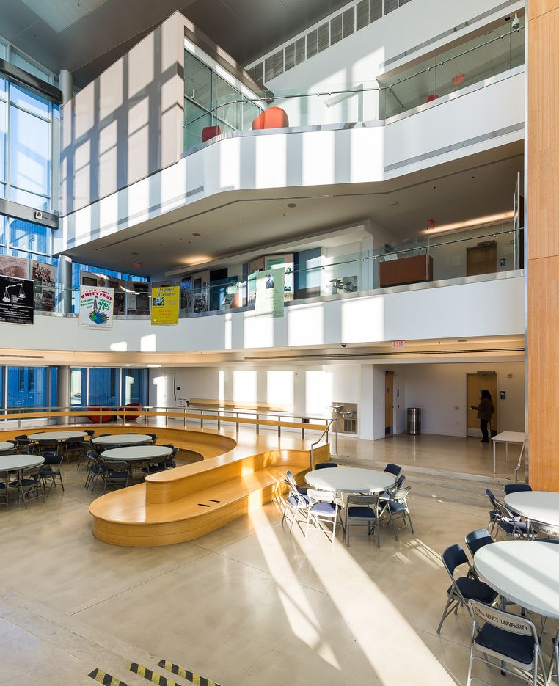
Gallaudet University
Notice the U design in the bottom left, allows for better conversation
Multi-tier design allows for people to follow conversations at different heights (spherical)
Image Copyright: Gallaudet University and Studio 27 Architects

Slide 25
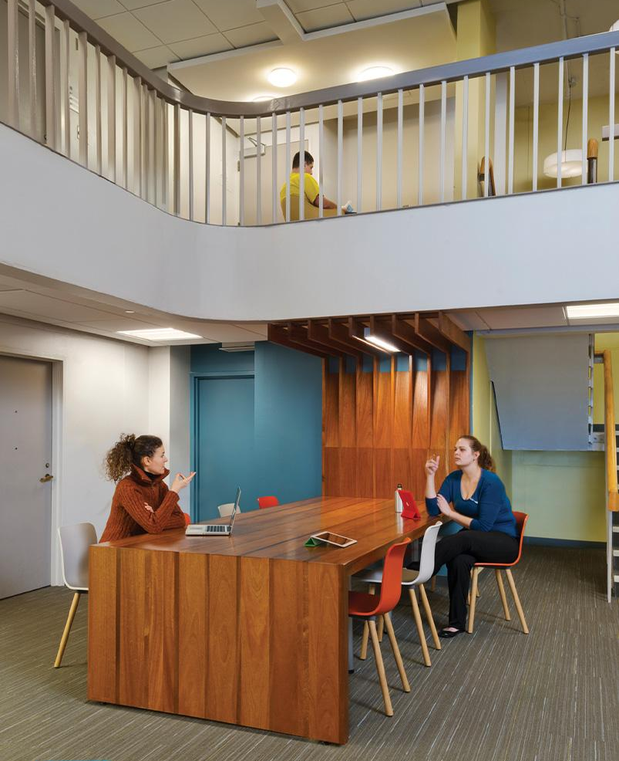
Gallaudet University (cont.)
Multi-height design for better spatial communication
Wood Tables are good for passing vibrations. If you want someone's attention, you can tap on the wood table.
Image Copyright: Gallaudet University and Studio 27 Architects

Slide 26
Closing Thoughts
We Should use the Growing Trend of PCR to Improve our Care
Our Ability to Flourish Depends on How we Re/Imagine Ourselves
We are who we are because of, not in spite of!

Slide 27
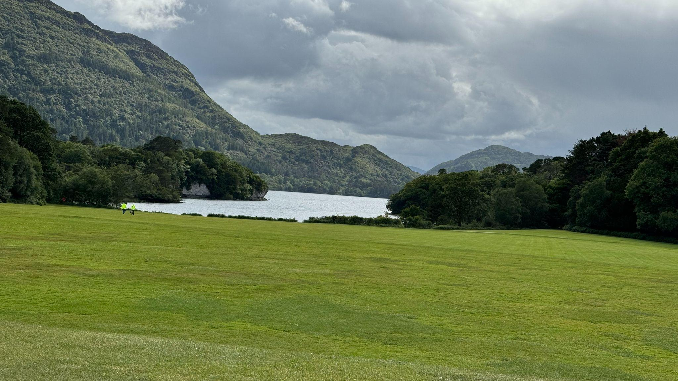
Intersex Personhood: A Primer
N

Slide 28
What people are saying
With this app, I’m confident to plan a trip to rural Vietnam
Wendy Writer, CA
Visual translation feels like magic
Ronny Reader, NYC
Translate has officially inspired me to learn French
Abby Author, NYC
Quotes for illustration purposes only

